Slide 1
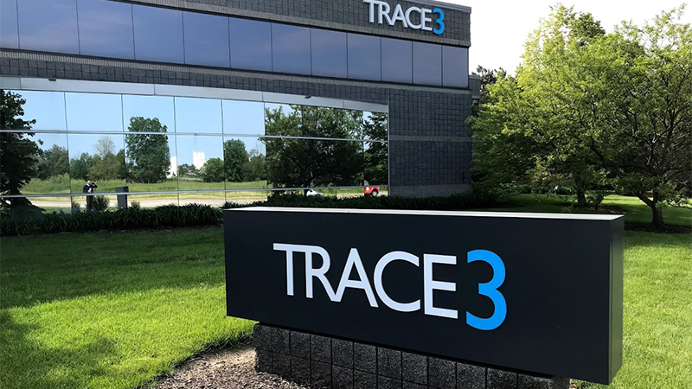
BUDT723
BPA TEAM 1
Meeting Management
Tool

Slide 2


Agenda
Current Project Status
Proposed System Architecture
Data Flow Diagram (Context, L0, L1)
Entity Relationship Diagram
Physical Data Flow Diagram
6. Synchronised Systems Model (CRUD Matrix)
7. Candidate Solutions Matrix
8. Feasibility Analysis Matrix
9. Input and Output Design
10. Implementation Plan

Slide 3
Current Project Status
# | Item Description | Status
1 | SOW Approval | ✅
2 | System Analysis Report Approval | ✅
3 | Proposed System Design Architecture | ✅
4 | Pre-meeting and Post-meeting Survey Methodology | ✅
5 | Data Processing and Storage Methodology | ✅
6 | Analytics Dashboard Content Finalization | ⌛
7 | Implementation Phase Planning and Client Feedback | ⌛

Slide 4
Proposed System Architecture
1. Data Collection:
- Scheduled meeting data from Outlook calendar
- Meeting transcripts/closed captions
- Participant attendance
2. Data Processing:
- Speech-to-text conversion (e.g., Whisper by OpenAI)
- Meeting summarization
3. Data Storage:
- Meeting database
- User database
4. Fetching data from Meeting Tools :
- API integration with meeting applications (e.g., WebEx, Teams)
- Verification and storage of ad-hoc meetings
5. User Interface:
- Dashboard for admins, organizers, participants
- Access to all meeting data (invitees, attendance, agenda, summary, etc.)
- Metrics and key performance indicators (for projects & resources)
- Overall meeting analytics
6. Feedback Mechanism:
- Pre-meeting survey for organizers (agenda, supporting documents)
- Post-meeting survey for participants (feedback, questions)
- Survey data storage in the meeting database
7. Scheduled Tasks/Services:
- Early morning data collection from Outlook (CRON jobs)
- End-of-day meeting summarization

Slide 5
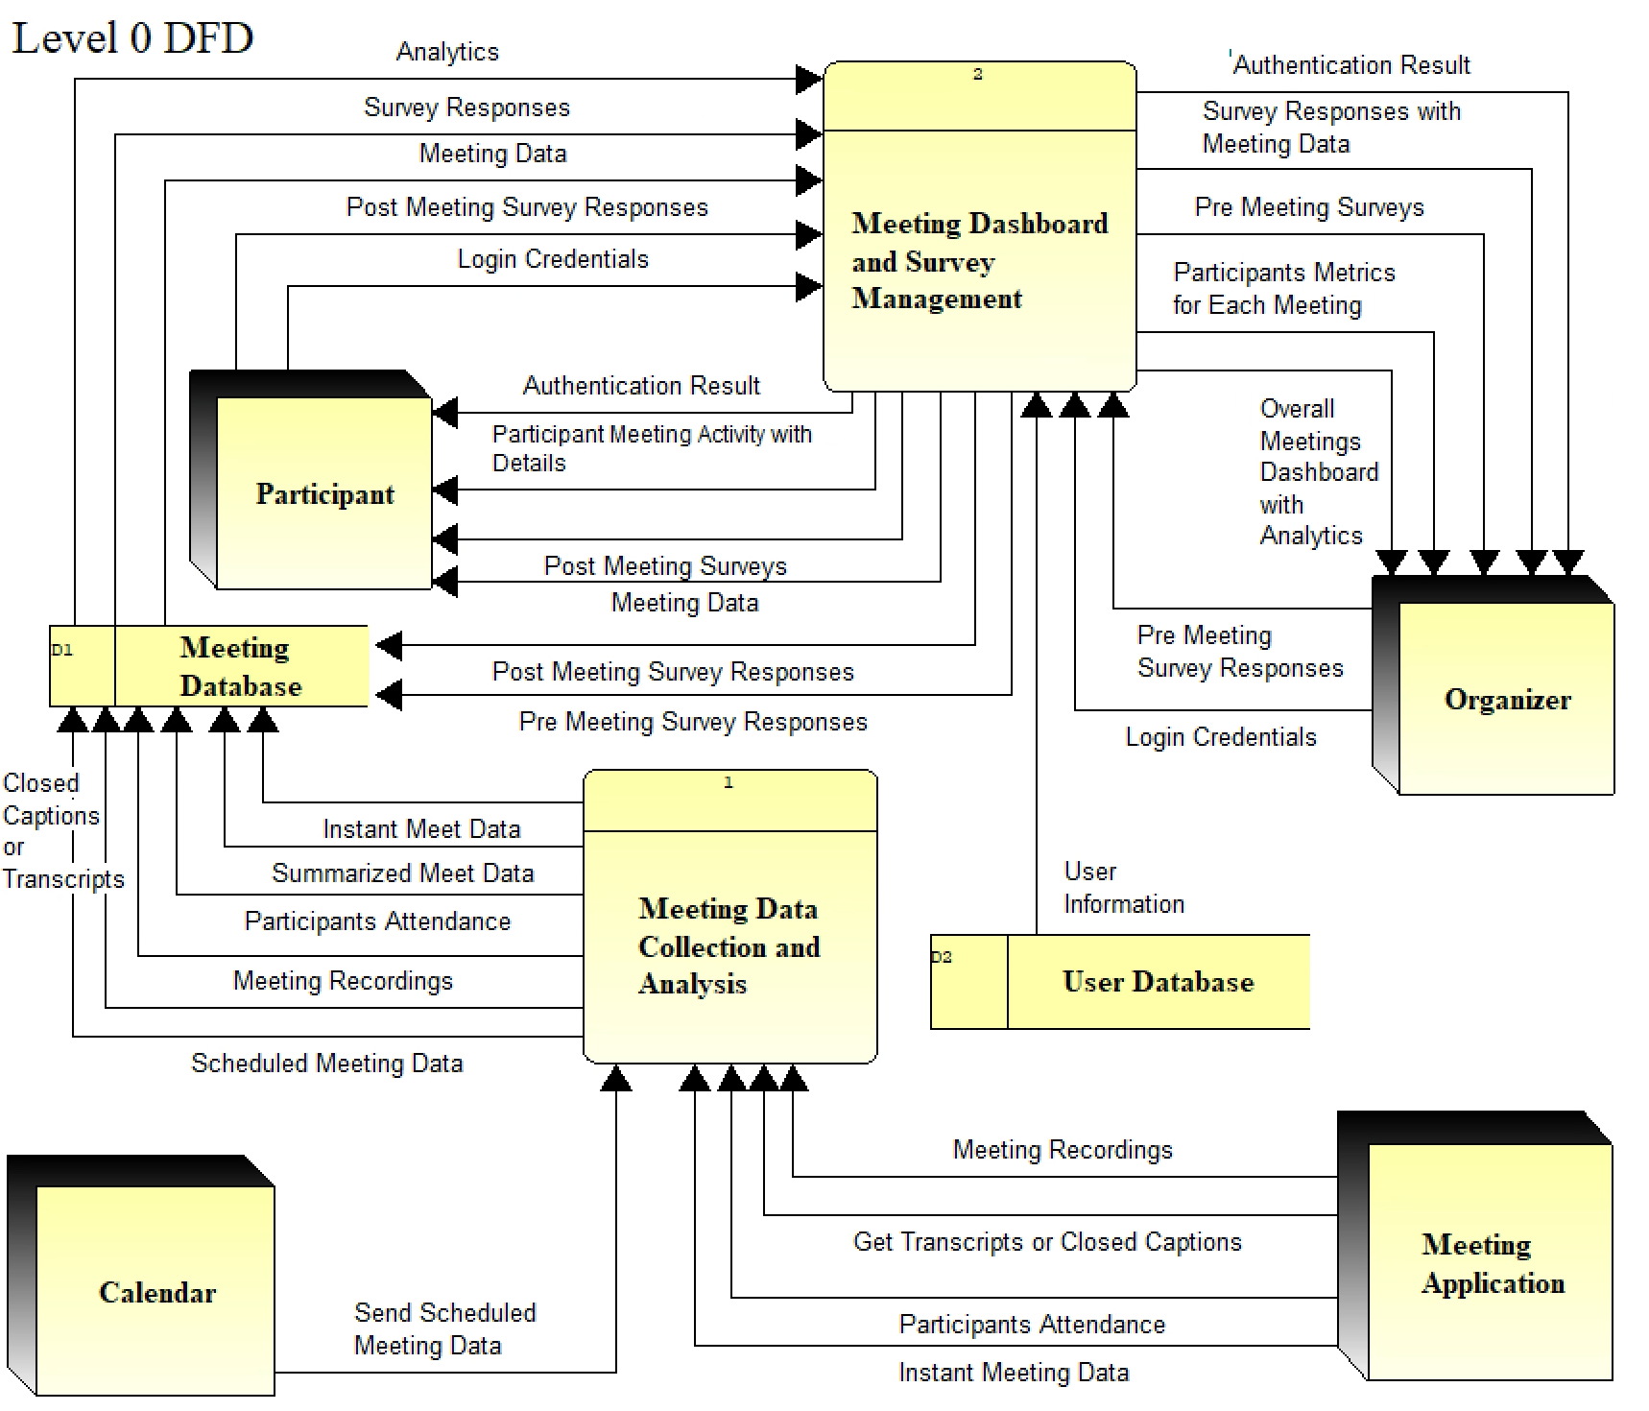
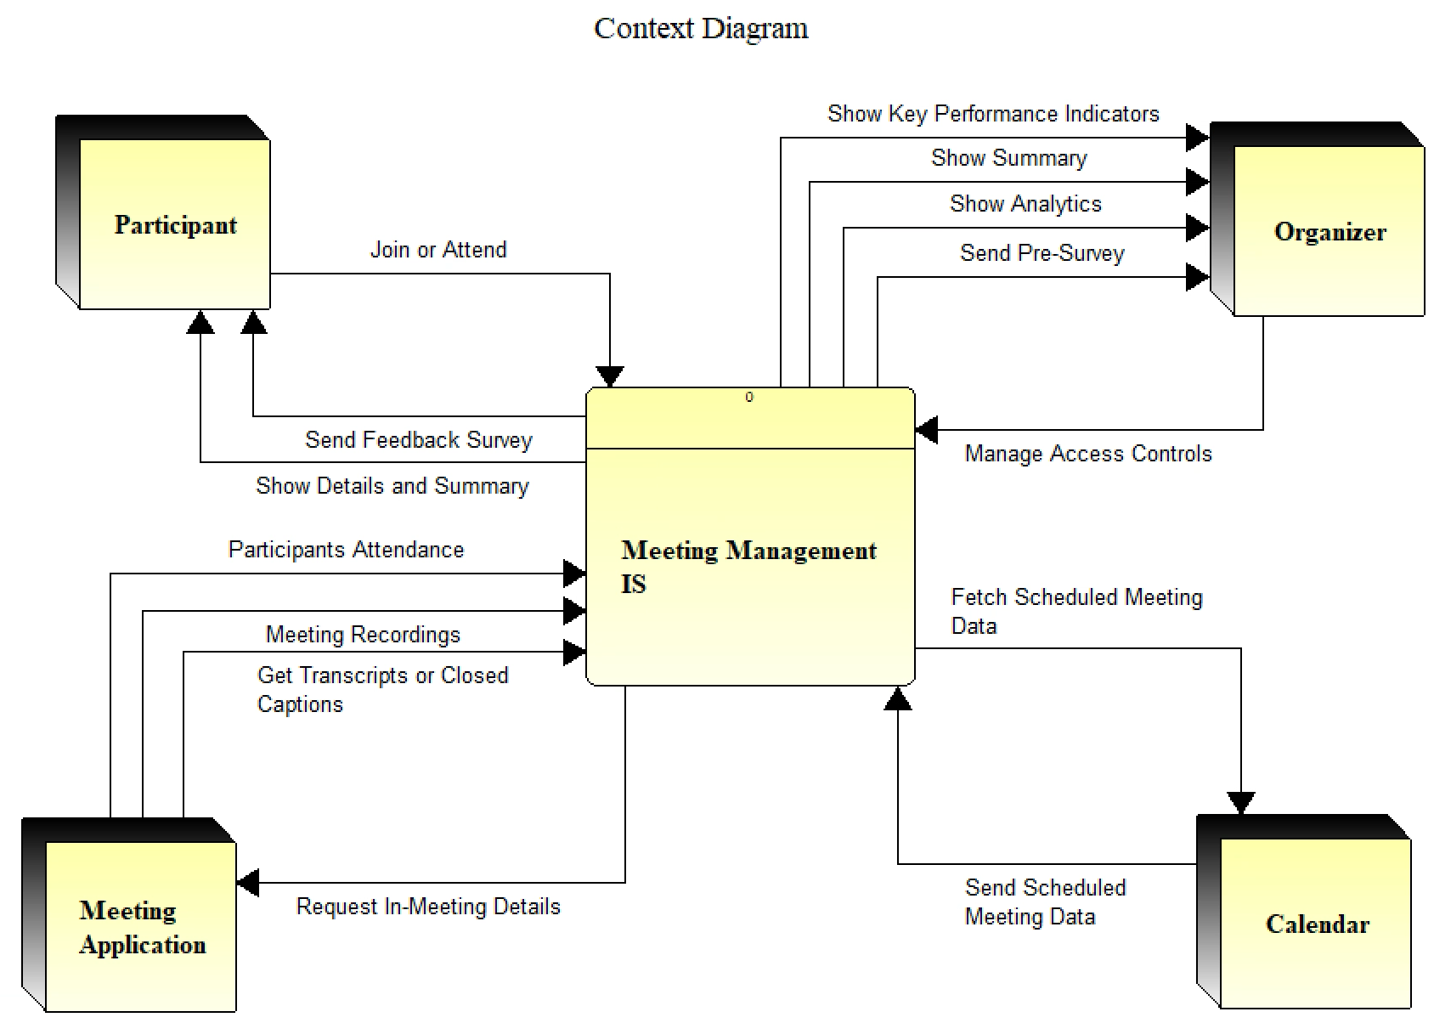
Data Flow Diagram

Slide 6
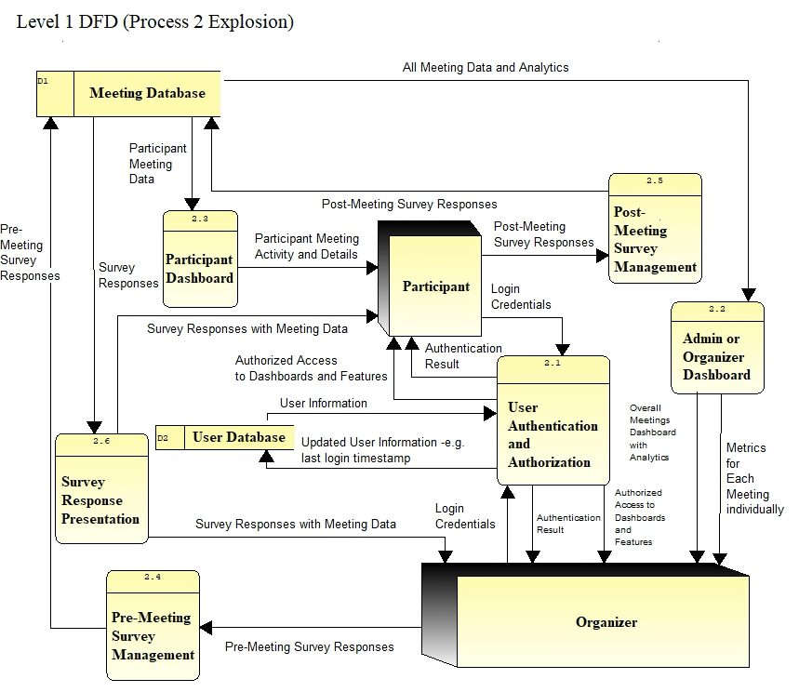
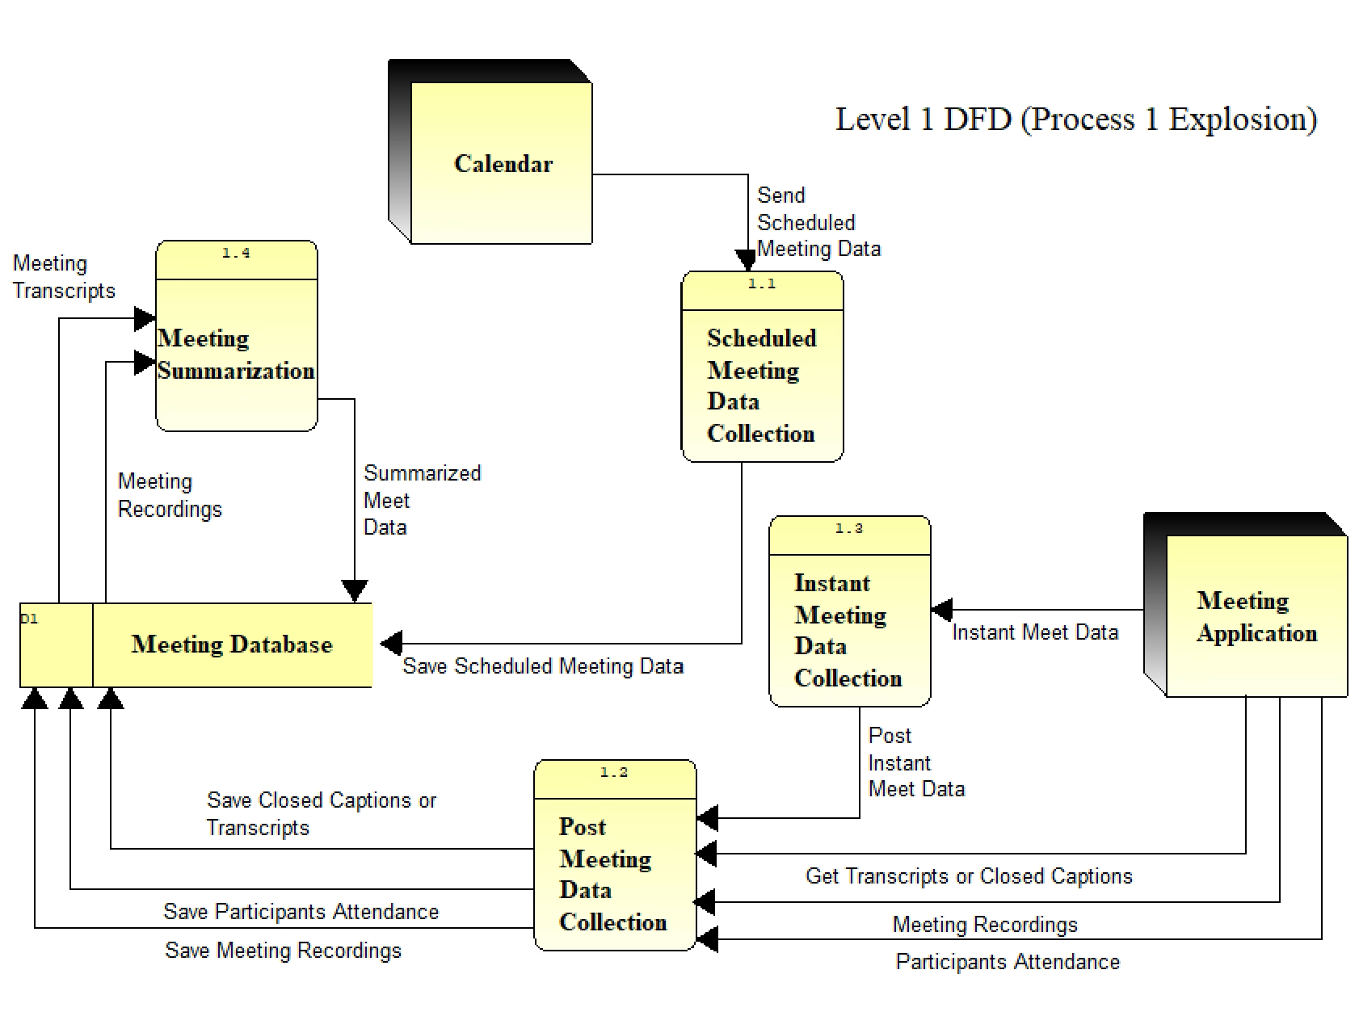
Data Flow Diagram

Slide 7
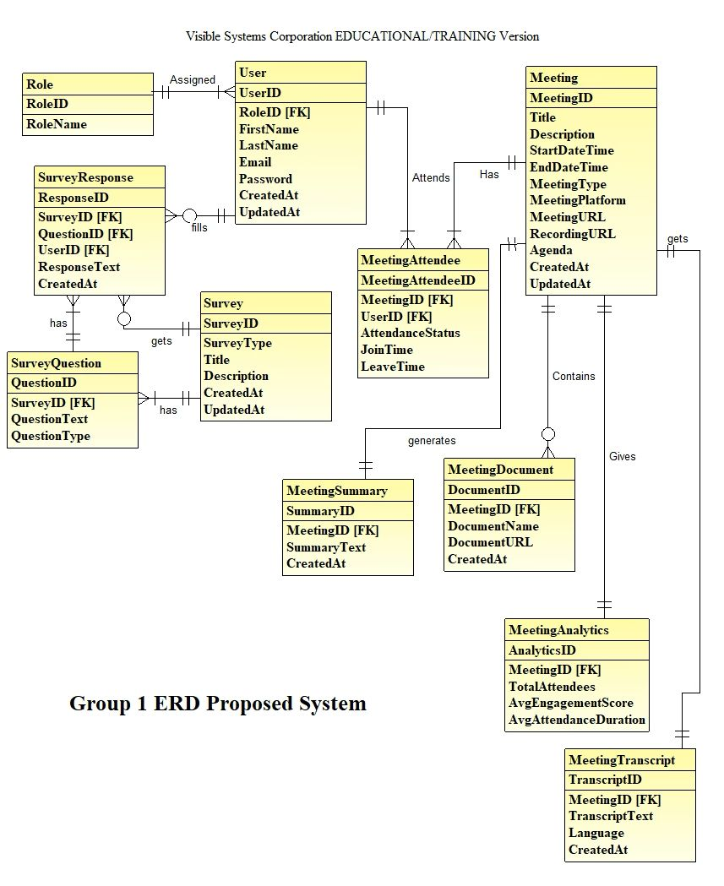
Entity Relationship Diagram

Slide 8
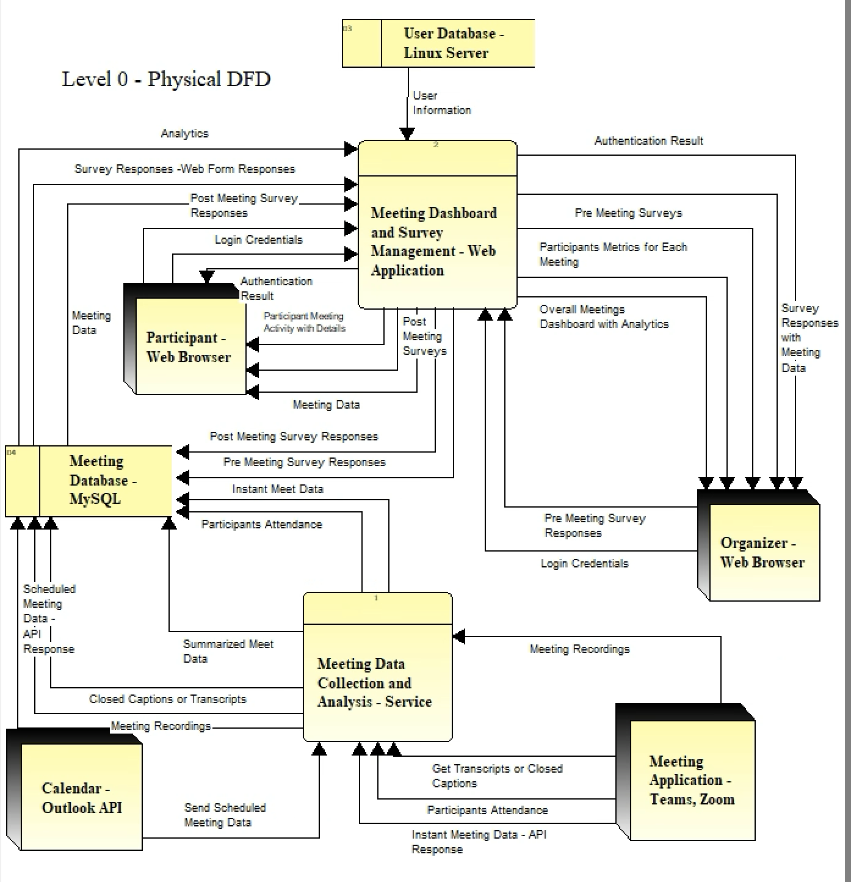
Physical Data Flow Diagram

Slide 9
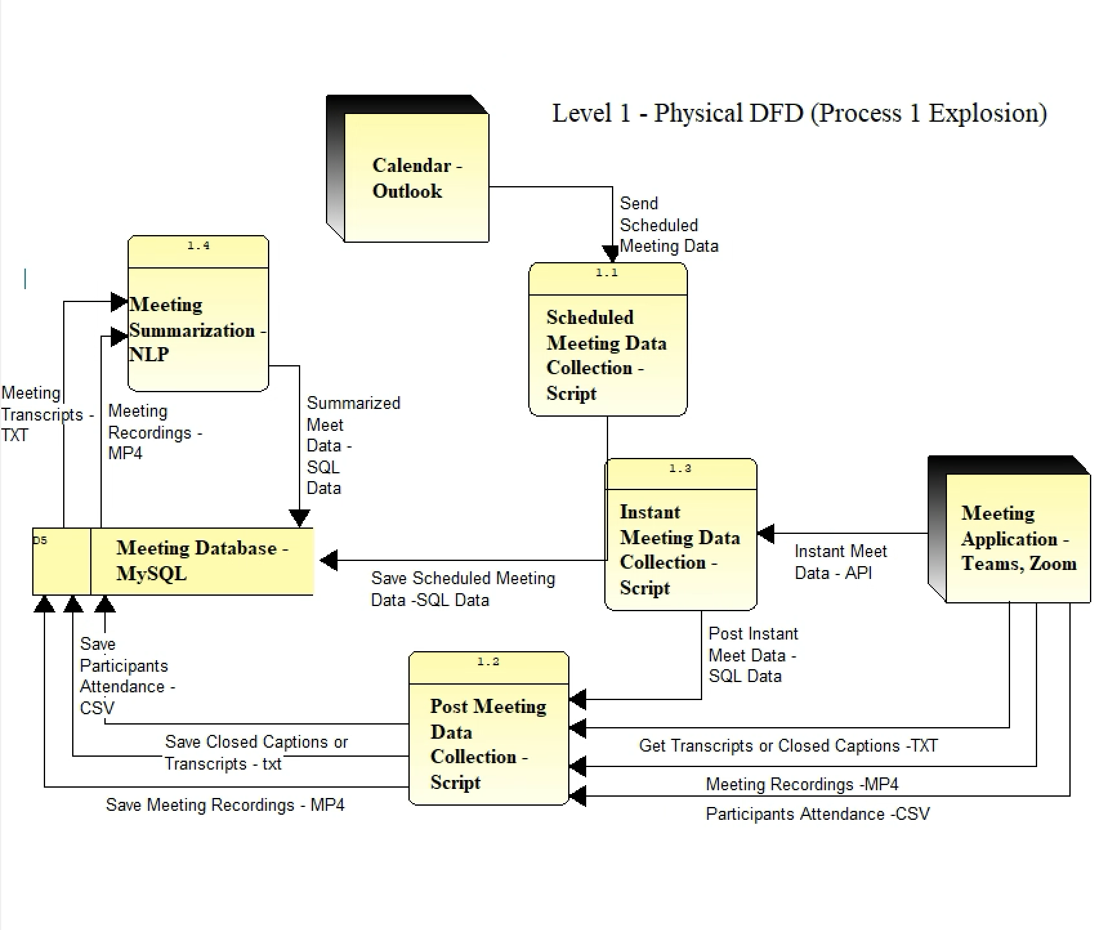
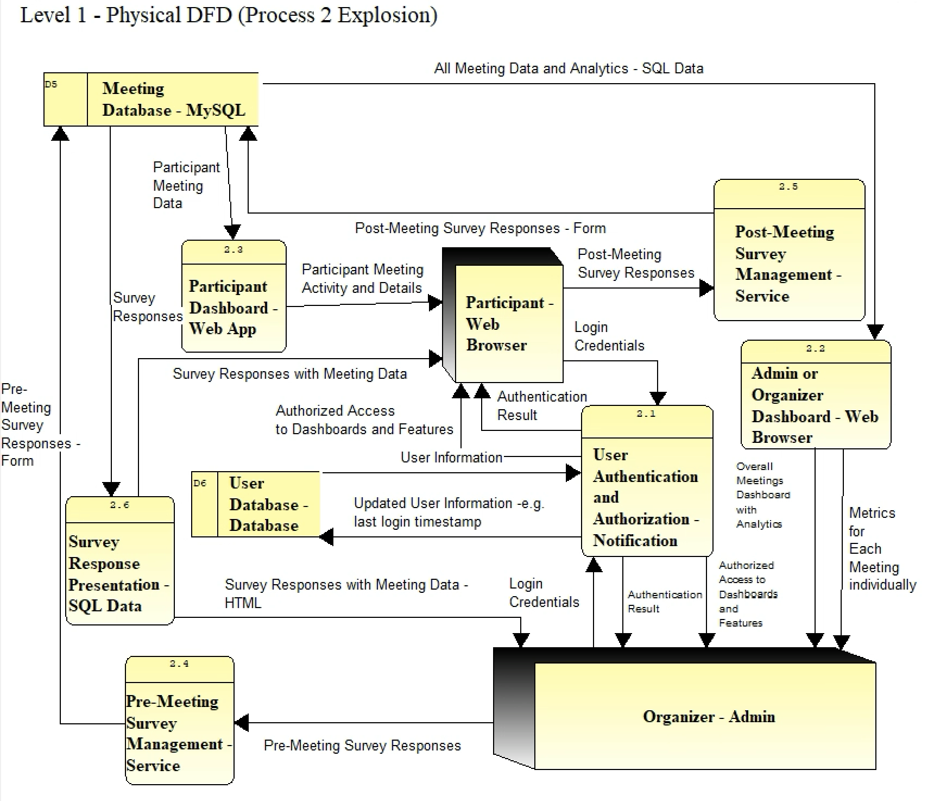
Physical Data Flow Diagram

Slide 10
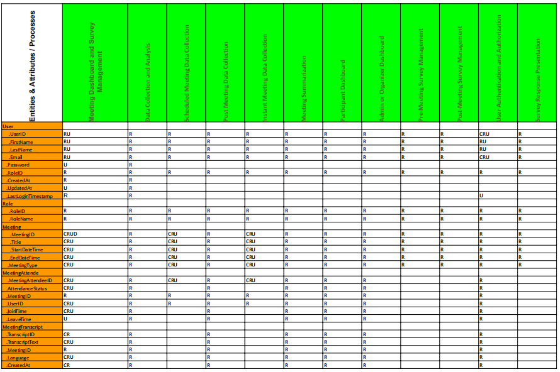
Synchronised Systems Model
(Data-to-Process CRUD Matrix)

Slide 11
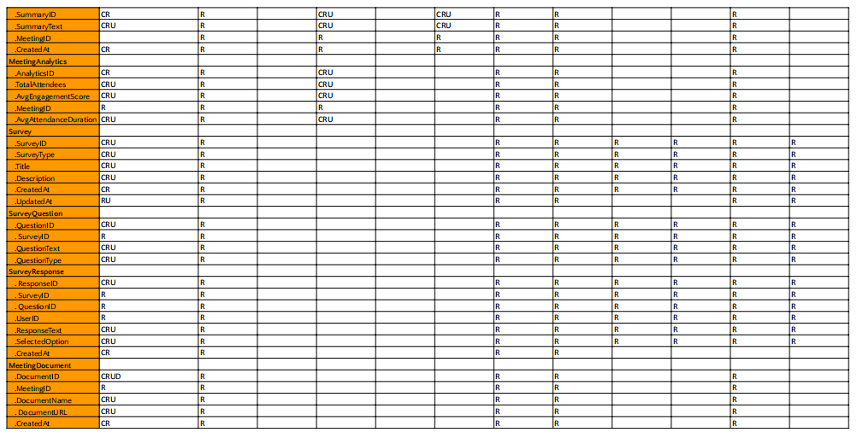
Data-to-Process CRUD Matrix

Slide 12
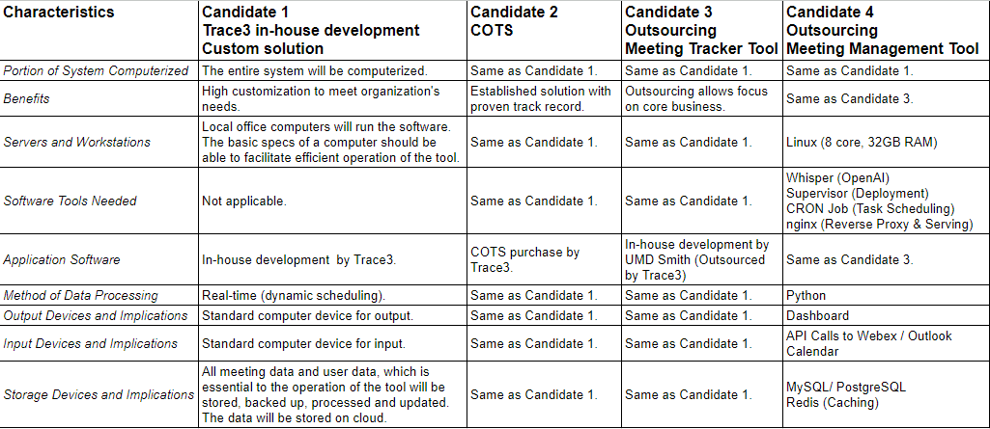
Candidate Solutions Matrix

Slide 13
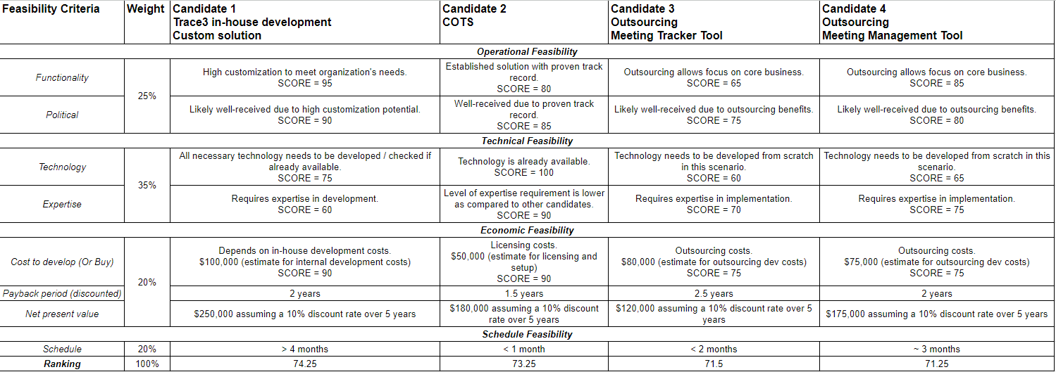
Feasibility Analysis Matrix

Slide 14
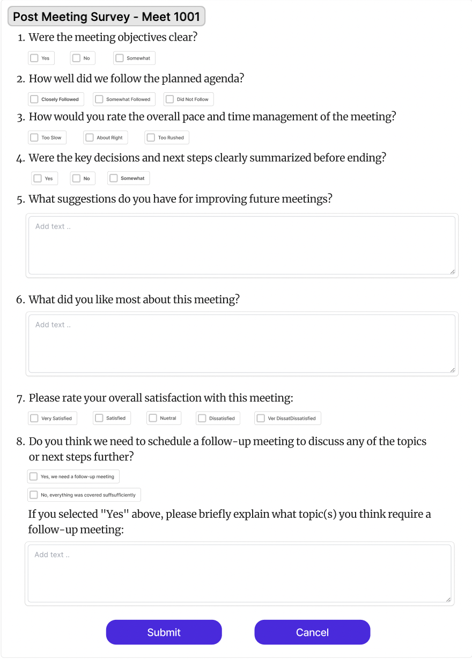
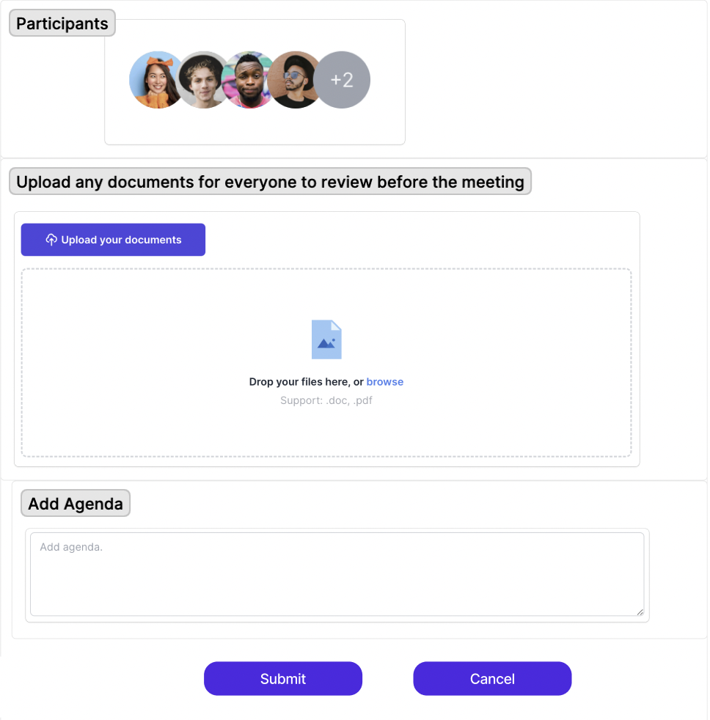
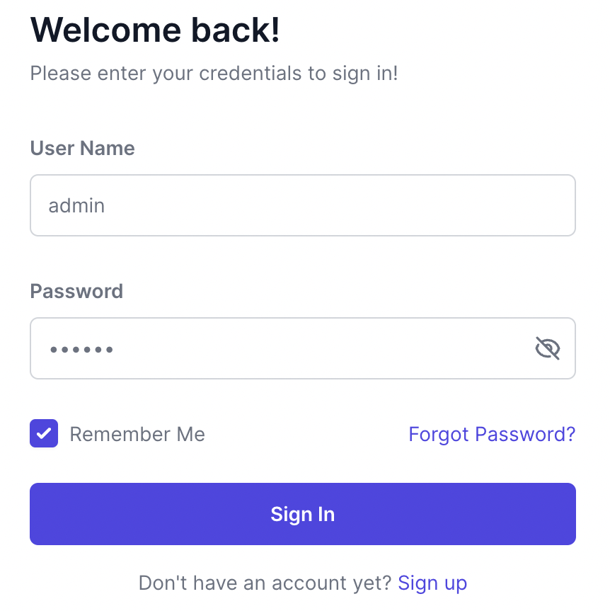
Input Design

Slide 15
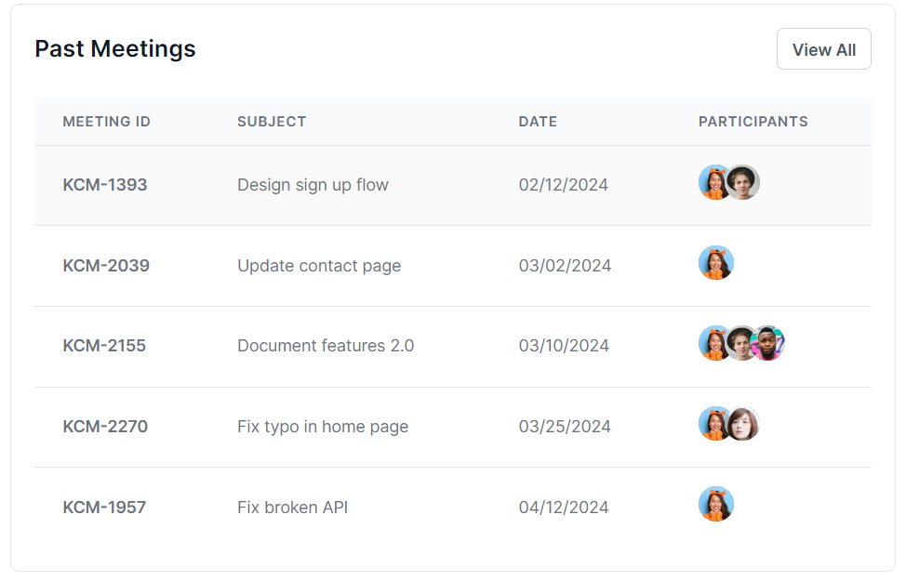
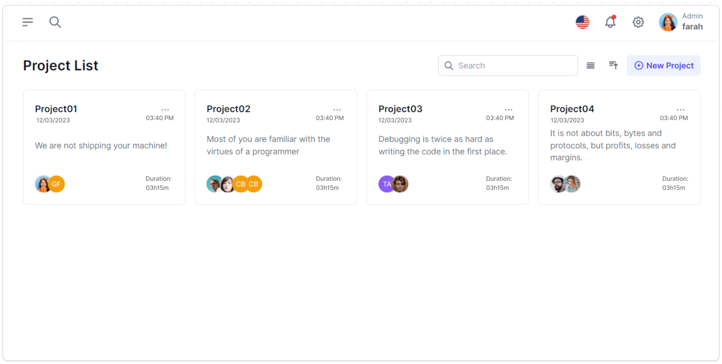
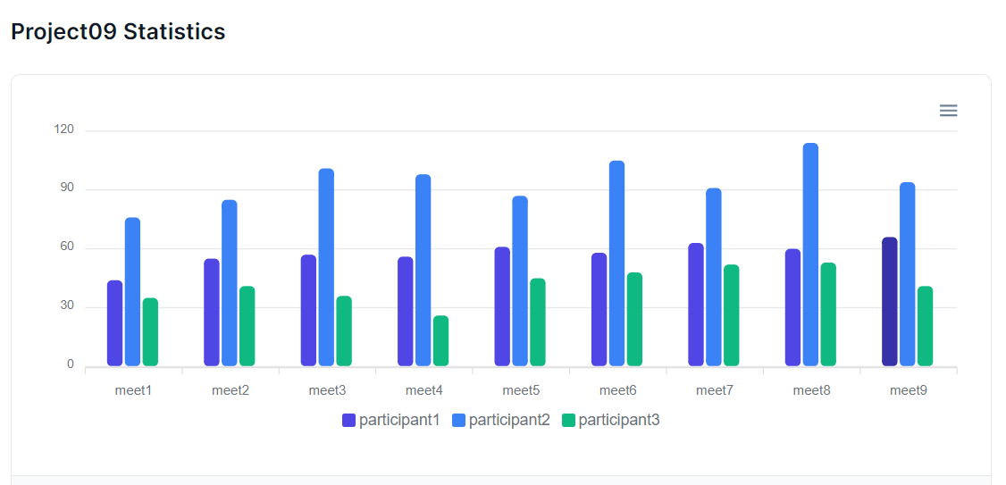
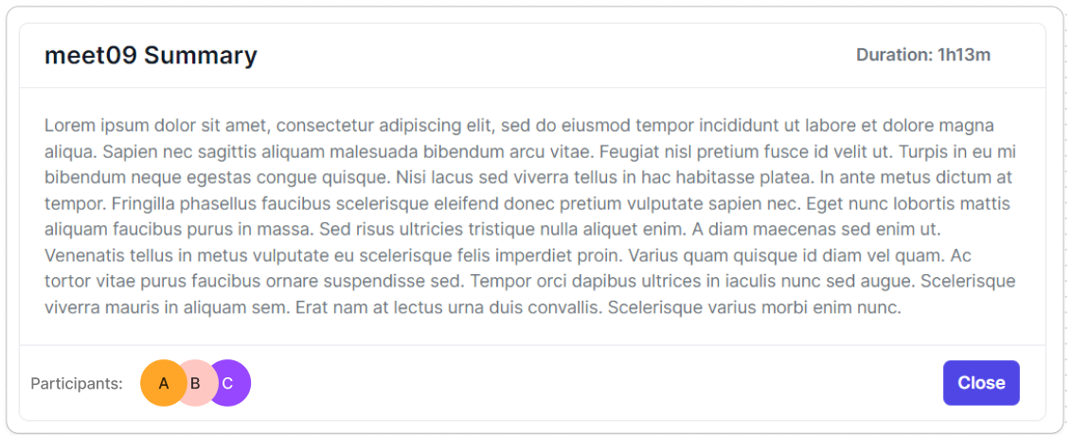
Output Design

Slide 16
Implementation Plan
1. Implementation Kick-off
Software APIs, Cronjobs and AI tools (Whisper by OpenAI)
Dummy data from Trace3
Hardware components (Linux servers, supervisor)
2. Installation and Configuration
Deploying on host server
Setting up software and hardware
Integrating APIs and Cron Jobs
Configuring with Trace3's data
3. Data Migration
Transferring existing meeting data
Migrating Outlook calendar data
Integrating supplementary meeting data
4. Testing
Alpha testing (functionality, Speech-to-Text)
Beta testing with user involvement
5. Go-Live, Hypercare & Transition
Deploying on production servers
User transition from old to new system

Slide 17
THANK YOU!
Please let us know if you have any questions.

